Slide 1
Capítulo 11
Por: Olivia y Margarita

Slide 2


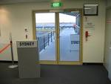
Getting around an airport - Departure
El aeropuerto
El destino
La puerta de salida

Slide 3
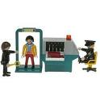
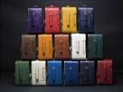

Departure Continued
El control de seguridad
El equipaje
El avion

Slide 4



Departure Continued
El pasaporte
El número del vuelo
El pasajero

Slide 5

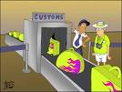

Getting around an airport - Arrival
El control de pasaportes
La aduana
El reclamo de equipaje

Slide 6
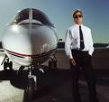

Identifying Airline Personnel
El piloto
El asistente de vuelo

Slide 7

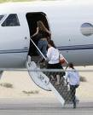

Describing Airport Activies
Despegar
Abordar
Aterrizar

Slide 8

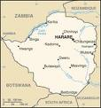

Airport Activities & Other Useful Expressions
Hacer un viaje
El país
Extranjero

Slide 9
Los Irregulares del Presente
Have an irregular “yo” form with a “g” in it
EX:
  HACER: yo hago
  SALIR: yo salgo
  PONER: yo pongo
  TRAER: yo traigo (has an extra “I”)
  VENIR: yo vengo (e ie stem changer)

Slide 10
Saber vs. Conocer
SABER means to know a fact, express knowledge or ignorance, and to know how to do something.
YO SÉ
CONOCER means to be acquainted with person, place, or thing. To know a person.
            YO CONOZCO

Slide 11
The Present Progressive
(Describing what is happening)
Compound tense : 2 PARTS
estar + participio presente
PART 1: ESTAR IN THE PRESENT
PART 2: PARTICIPIO PRESENTE
(verbs in the –AR: stem + ando
verbs in the –ER/IR: stem + iendo

Slide 12
Irregulares
I to Y (because you can’t have 3 vowels in a row)
IR = YENDO
E to IE (viniendo and diciendo)

Slide 13
QUIZ!
What are the “yo” forms of saber and conocer?
How do you congugate a present progressive verb?
What is the “ir” form in the present participle?

